Slide 1
RESTAURANT REVENUE PREDICTION
OBJECTIVE:PREDICT THE REVENUE OF THE RESTAURANT IN A GIVEN YEAR BASED ON DIFFERENT CATEGORIES

Slide 2
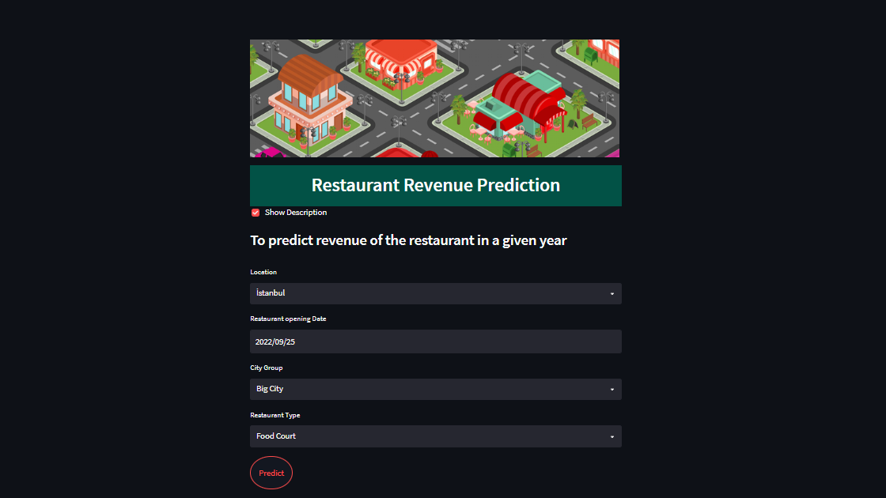
INPUT:

Slide 3
I. INTRODUCTION
# Restaurant-Revenue-Prediction
Food industry plays a crucial part in the enhancement of the country’s economy. This
mainly plays a key role in metropolitan cities. Where restaurants are essential parts of
social gatherings and in recent days there are different varieties of quick-service
restaurants like food trucks, takeaways. With this recent rise in restaurant types, it is
difficult to decide when and where to open a new restaurant.
In recent days, even restaurant sites also include a large investment of time and capital.
Geographical locations and cultures also impact the long-time survival of the firm. With
the subjective data, it is difficult to extrapolate the place where to open a new restaurant.
So TFI company needs a model such that they can effectively invest in new restaurant sites. This
competition is to predict the annual restaurant sales of 100,000 regional locations.
We are asked to predict the revenue of the restaurant in a given year

Slide 4
Overview :
Over 1,200 quick service restaurants across the globe, TFI is the company where it owns several well-known restaurants across different parts of the Europe and Asia.They employ over 20,000 people in Europe and Asia and make significant daily investments in developing new restaurant sites. We have been encountered with four different types of restaurants. They are inline, mobile, drive-thru, and food court. So deciding to open a new restaurant is challenging with these emerging quick-service restaurants. In recent days, even restaurant sites also include a large investment of time and capital. Geographical locations and cultures also impact the long-time survival of the firm. With the subjective data, it is difficult to extrapolate the place where to open a new restaurant. So TF1 needs a model such that they can effectively invest in new restaurant sites. This competition is to predict the annual restaurant sales of 100,000 regional locations.

Slide 5
Data Overview :
Id: Restaurant ID
Open Date: Opening date of a restaurant
City: City where restaurant is located
City Group: Type of the city. Big cities, or Other.
Type: Type of the restaurant. FC: Food Court, IL: Inline, DT: Drive Thru, MB: Mobile
P1- P37: There are three categories of these obfuscated data.
Demographic data are gathered from third party providers with GIS systems. These include population in any given area, age and gender distribution, development scales. Real estate data mainly relate to the m2 of the location, front facade of the location, car park availability. Commercial data mainly include the existence of points of interest including schools, banks, other QSR operators.
Revenue: The revenue column indicates transformed revenue of the restaurant in a given year and is the target of predictive analysis

Slide 6
FLOW CHART
Kaggle
DATA COLLECTION
Data Cleaning
->check the dataset for null values
->Filling NaN values with mode,median and mean
->Droping the columns that are non impacting
Data Preprocessing
->Rearranging the columns.
->Performing One Hot Encoding
On Nomial Categorial data.
-> Performing Label encoding
On Ordinal Categorial data.
->Convert string datatype to datatime object.
Model Generation
(Random Forest Regression)
User input
Prediction
Restaurant Revenue Prediction

Slide 7
LIBRARIES USED:
1.NUMPY
2.PANDAS
3.MATPLOTLIB
4.SEABORN
5.SCIKIT LEARN
INTERNET.
SOURCE:-
ALGORITHM USED
RANDOM FOREST
LINEAR REGRESSION.

Slide 8
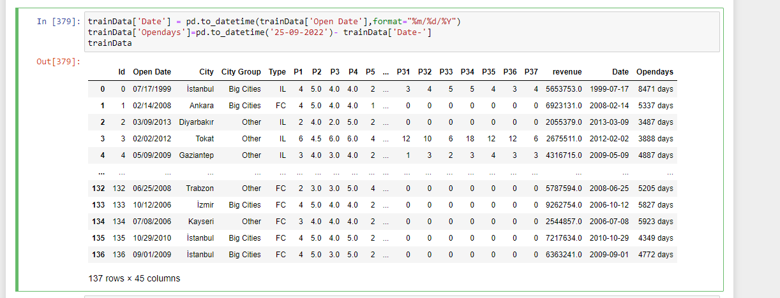
EXPLORATORY DATA ANALYSIS(EDA)
For this we require pandas to_datetime to convert object data type to datetime dtype.
**.dt.day method will extract only day of that date**\ **.dt.month method will extract only month of that date**

Slide 9
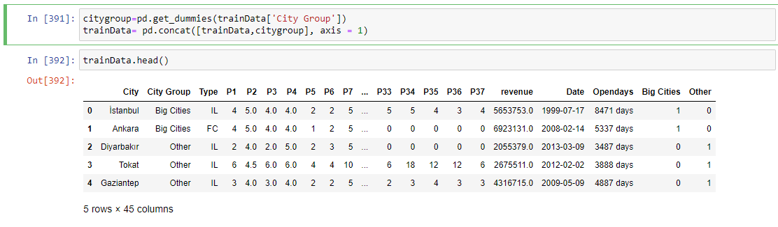
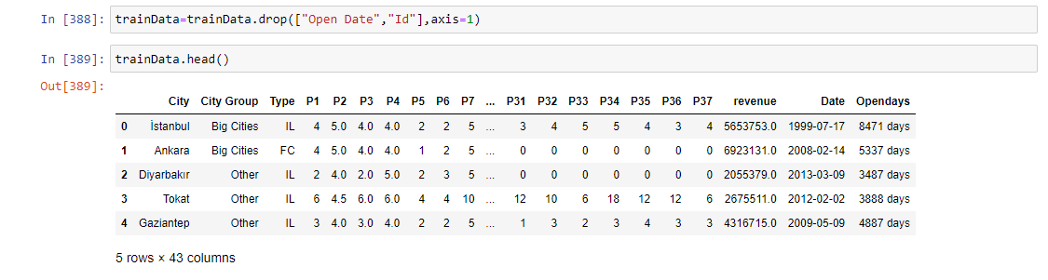
Get_dummies for categorical data
Drop unneccesarily Columns in the dataset

Slide 10
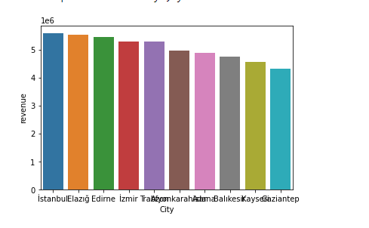
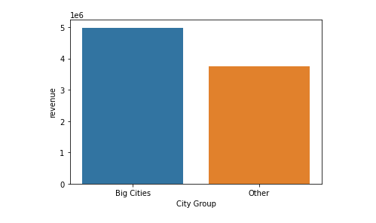
VISUALIzATION

Slide 11
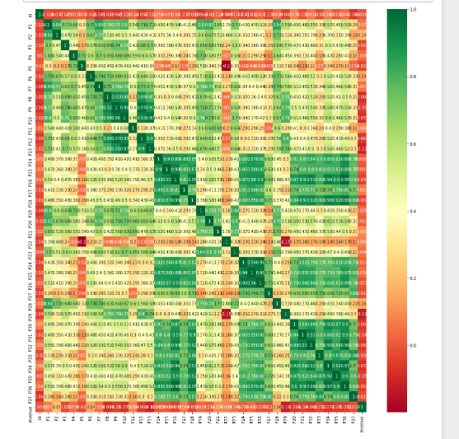
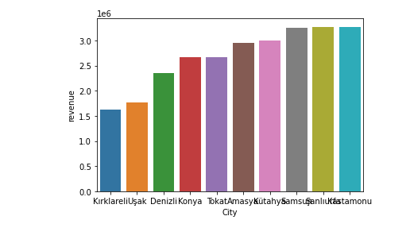

Slide 12
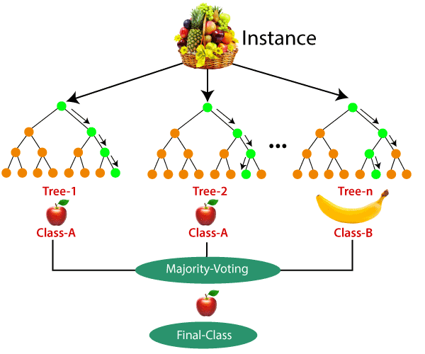
RANDOM FOREST

Slide 13
As the name suggests, "Random Forest is a classifier that contains a number of decision trees on various subsets of the given dataset and takes the average to improve the predictive accuracy of that dataset." Instead of relying on one decision tree, the random forest takes the prediction from each tree and based on the majority votes of predictions, and it predicts the final output.
The greater number of trees in the forest leads to higher accuracy and prevents the problem of overfitting.
ADVANTAGES:-
It takes less training time as compared to other algorithms.
It predicts output with high accuracy, even for the large dataset it runs efficiently.
It can also maintain accuracy when a large proportion of data is missing.

Slide 14
Conclusion
By using My model TFI company can decide whether to open a new restaurant in a particular area.
My model predicts the annual revenue of the restaurant placed in different places and with different opening dates.

Slide 15
UI DEVELOPMENT
In this project, Streamlit framework has been used for the UI development. The main web page of the project takes the required inputs from the user in order to predict the revenue of the Restaurant
After inputting all the fields, the user will click the Submit” button and then the form is submitted. Model enters the scenario at the backend after the submission of the form.
The inputs take the help of the historical data and are analysed through supervised machine learning techniques resulting in the prediction of the annual revenue of the restaruant.
The routing of the pages is done based on the URLs. When the browser finds the ‘/’ in the URL it redirects the user to the home page. After the submission of the form, the user is redirected to the '/result' URL i.e., to the result page where we can see the final result i.e., the prediction of the annual revenue of the restaruant .

Slide 16


